Slide 1
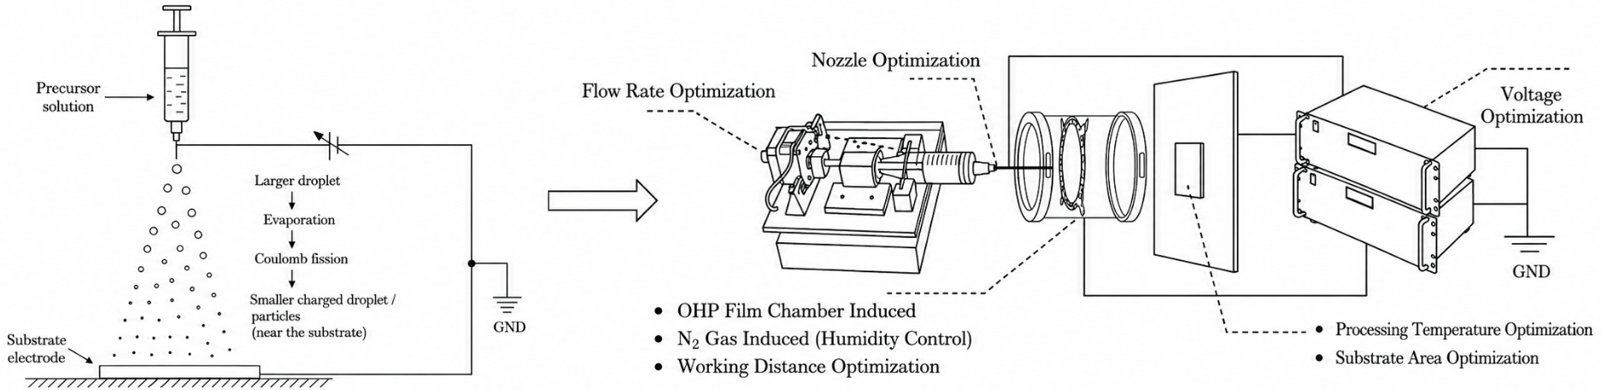
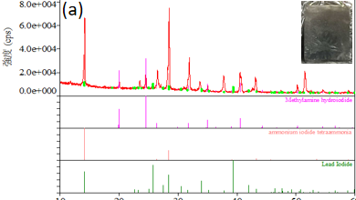
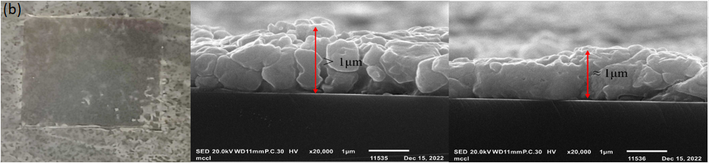
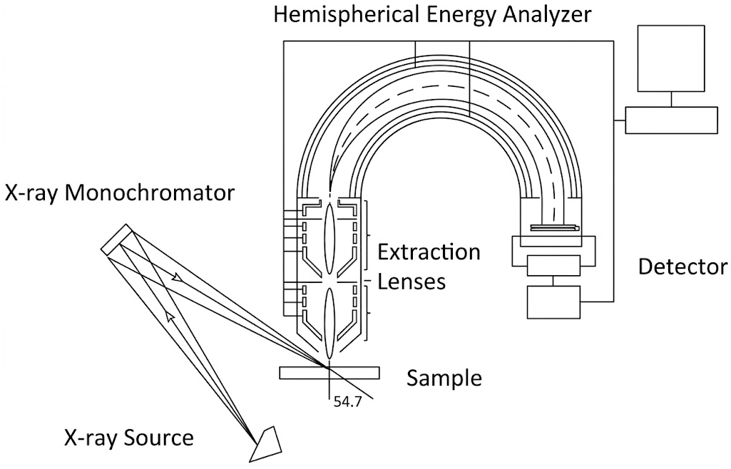

Past Research Foundation
Research Proposal · Lin Weiye
EIP film fabrication experience feeding into phase-segregation mechanism decoupling
Trajectory
EIP fabrication platform and tunable processing window
2021
Remote learning & process planning
Designed an actionable EIP optimization plan.
2022–23
Electrostatic spray fabrication
Flow rate
Nozzle
Humidity / N2
Voltage
Temperature
Working distance
Prepared ~1 µm MAPbI3 films; validated by XRD and cross-section SEM.
Film quality evidence
Next characterization logic
2023–24
From lab to industry
Translated thin-film experience into scalable process thinking.
XRD confirms perovskite phase formation; cross-section SEM shows compact ~1 µm film morphology.
Use XPS / PL mapping / SEM-EDS to separate ion migration, trap-state evolution, and phase segregation.
Review article · 52 citations
LIN WEIYE · RESEARCH PROPOSAL
Optimized one-page draft

